Slide 1

Manufacturing Task Tracker
& IRIS CAP

Slide 2
Manufacturing Task Tracker
Manufacturing Task Tracker (MTT) is the centralized program for entering corrective actions and tasks for Safety, Environmental, Reliability, Quality, Health corrective actions and other Projects
You can create and edit corrective actions in IRIS just like you do today. However, they will be stored in central location with tasks from other systems (RI, LIFE, MOC, Outage, etc).
You can update via IRIS; from the weekly email notifications or go directly to MTT calendar of tasks.
LIFE
RI
MOC
Audit
IRIS
2

Slide 3
Current State:
MTT
Winder Audit
Project
Environmental
MOC
LIFE
RI
Outage
IRIS (2nd qtr 2012)
EHS Audit Findings
Environmental Quarterly Compliance
Integrating application
action plans centrally in MTT.

Slide 4
Overview
Updating Actions from within IRIS application
Updating task from Weekly Email
Using the Calendar
Default to items that you are responsible for
Changing selection criteria (example: All Environmental for your site)
Entering new items
Create Task Header
Add Task (Assign to role or responsible person) with due date
Recurrence Schedule,Subtask,Subsequent
Reporting Options

Slide 5
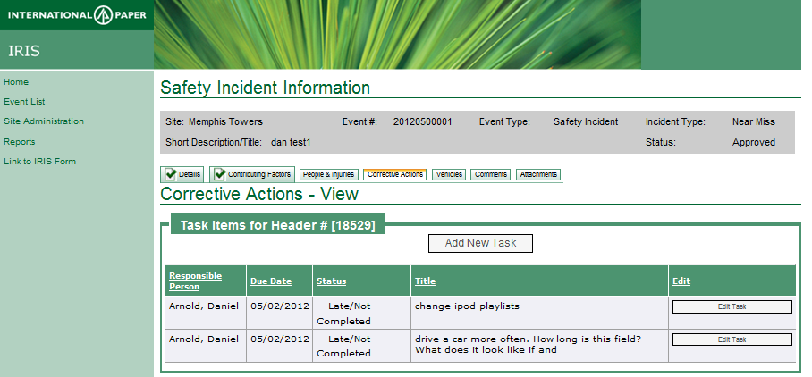
Updating Actions already in IRIS
All of the current corrective actions in IRIS will be migrated to MTT.
When you choose Corrective Actions tab on IRIS incident (same as before) and if tasks have already been
created for this incident, will display the list of corrective actions.
You can choose one to edit or add another tasks
Edit (description)
Reassign
Complete
Add attachments/links
Add subtask
Add another task

Slide 6
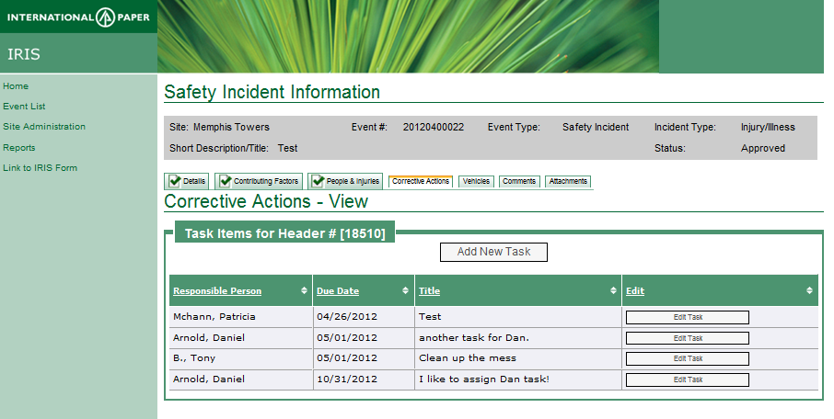
Update Tasks
If tasks already have been created, each will be listed when Corrective Action tab is chosen.
To add another task click on Add New Task button
Click on Edit Task to edit a task (description, add attachment/link, add comments, update status)

Slide 7
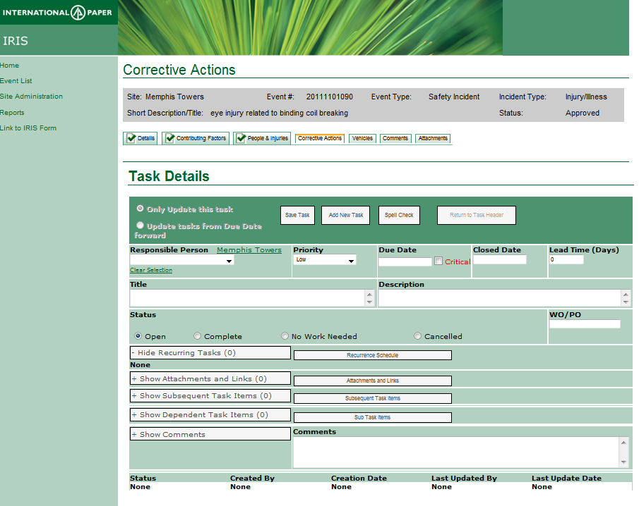
Add Task Items
If this is the first corrective action added to incident, fill in the information (responsible, priority, due date, title and click Save Task.
To add another task click on Add New Task button

Slide 8
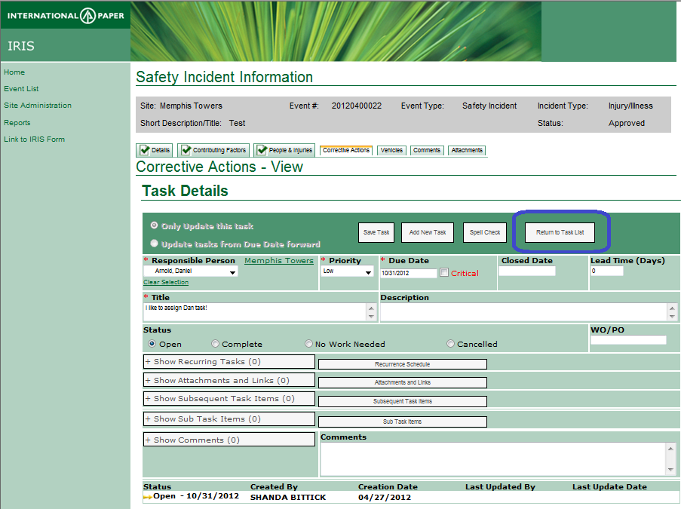
View all task
After adding more task, if you would like to view all the tasks again,
Click on Return to Task List

Slide 9
Next slides display alternative ways to update Actions outside of IRIS system.
You may still just use update action from within IRIS or email

Slide 10
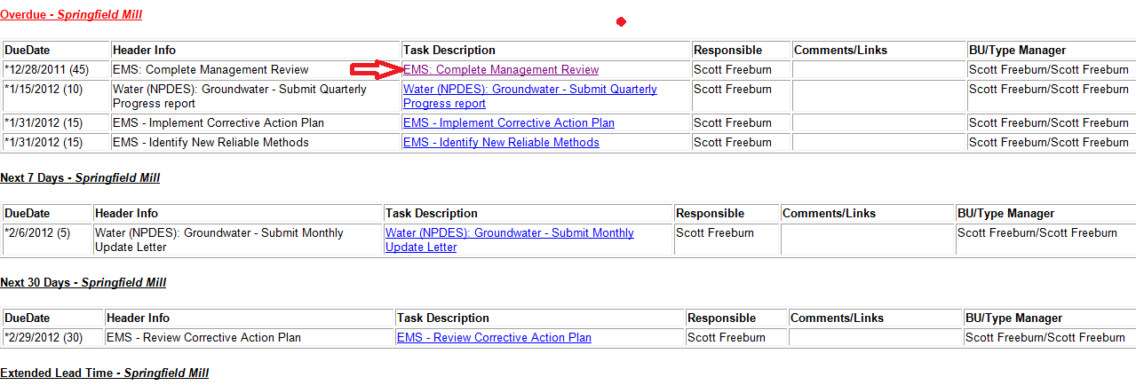
Email: Default Weekly for tasks you are responsible
You will receive weekly email on Thursday’s listing all tasks that you are responsible person. Click the hyperlink to go directly to the task to update information or complete task.
Health & Safety Manager’s will also receive weekly email on Sunday’s listing all task that are marked as H&S.

Slide 11

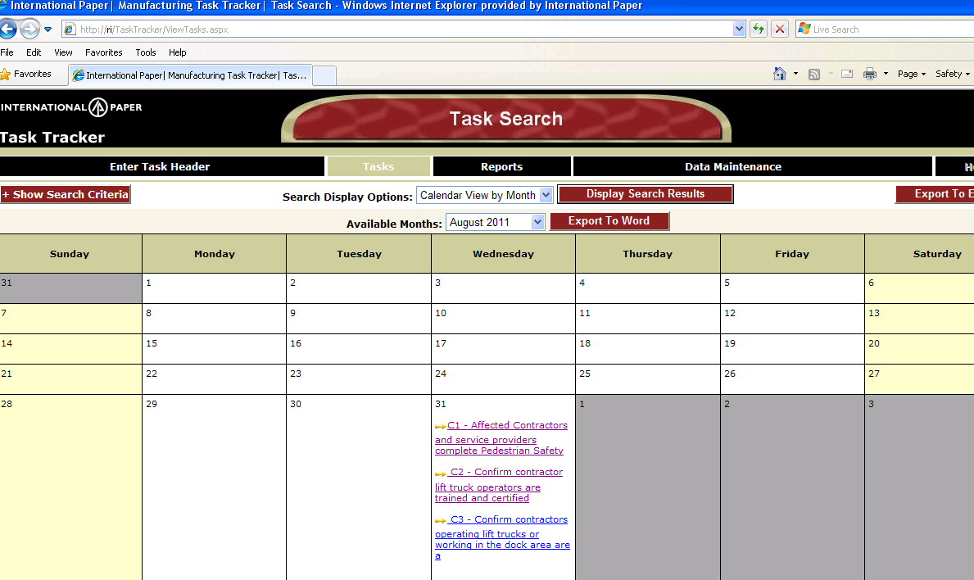
Directly access tasktracker
Open Internet Explorer
Type tasktracker in address bar
Calendar of all tasks assigned to you will be displayed

Slide 12
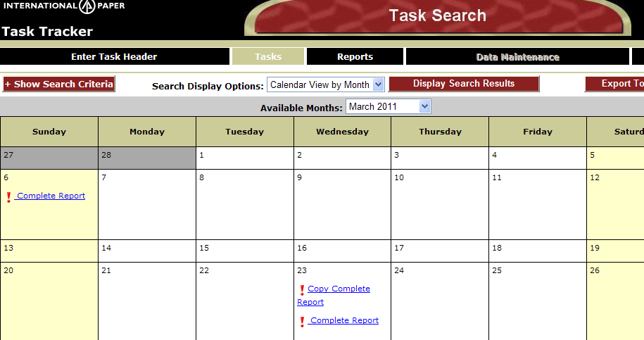
Default MTT view of Calendar with your Tasks
Click on any task to update or complete task or scroll thru calendar of tasks

Slide 13
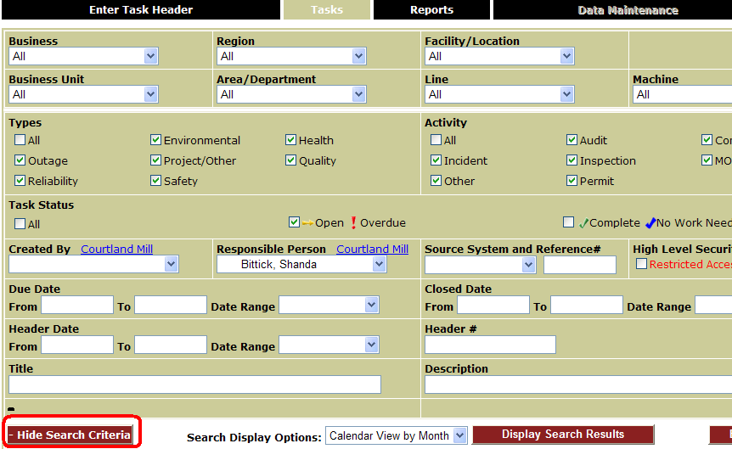
Show Search Criteria – Change Default MTT view
From TASKS (Calendar View) Click on Show Search Criteria to change defaults.
Default: Tasks assigned to YOU as the responsible person and are not complete
Defaults can be changed to set for facility, area, type, or combination of any of the selection criteria)
Click Display Search Results to see Calendar

Slide 14
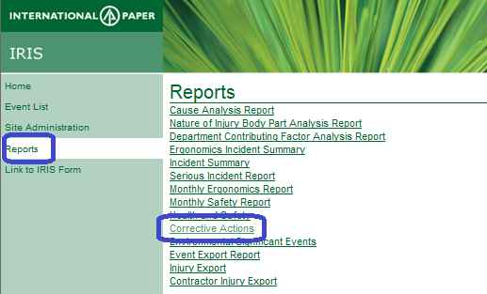
Reporting

Slide 15
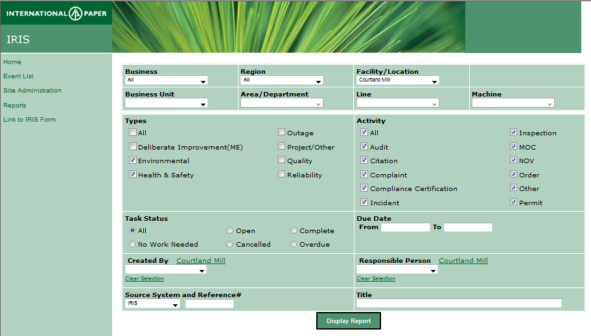
Default Report – Your site and Environmental & Health/Safety tasks from IRIS
Click Display report to run report with defaults.
You may change any of the selection filters and run report by clicking Display report

Slide 16
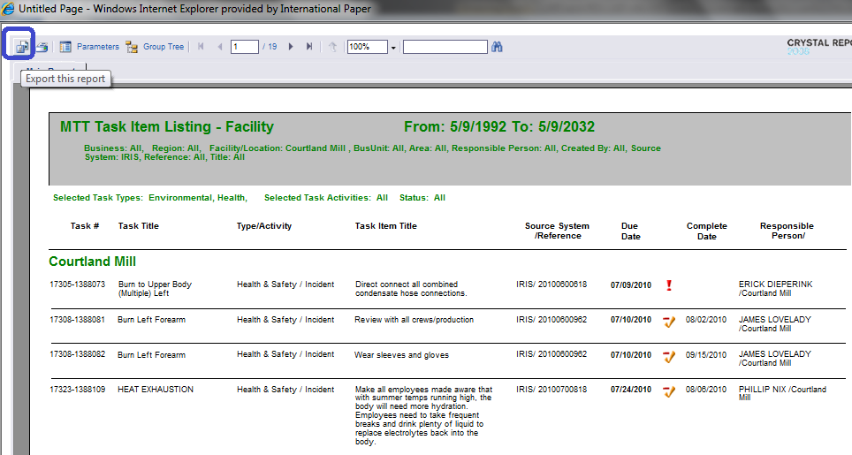
Report will be displayed in Crystal Viewer
Example report.
Click to export to PDF (highlighted in blue below)
Click to print (icon besides Export)

Slide 17
Other Features
AUTOMATED REPORT:
You can request to have report sent to a distribution list on any frequency.
Example: Facility manager and Business Unit Managers receive weekly overdue actions for their facility on Wed morning.
ASSIGN TASK TO ROLES
Roles are created to assign tasks across the Enterprise
(Example: Health & Safety role assigned to at least one person at each site to receive LIFE tasks)
May have multiple people in a role
Anyone in a role will see tasks assigned to that
role until it is completed or assigned
to a specific person
Roles are also used to escalate tasks that have

